Slide 1
Central bank seminar asia (China and Japan) Fixed Income
october 2025

Slide 2
Market Overview

Slide 3
Global Fixed income market outstanding
As of the end of 2024 the size of the global fixed income market exceeded $145tn growing by over $65tn over the 2013-2024 period
US accounts to 40.1% whilst China accounts for 17.10% and Japan 7.30%
The size of the US part has grown to over $60.1tn
Source: BIS,SIFMA, September 2025

Slide 4
inflation
Geopolitics (tariffs) fixing long-term positive correlations
CPI (%)
Source: Bloomberg, September 2025

Slide 5
central banks who ‘go’ the other way
.. however, this yet must be reflected in monetary policies
Source: CAIM, Bloomberg, September 2025

Slide 6
Complex global financial system
Negatively correlated assets welcomed
Monthly returns and proportional price changes, last three years
Post covid era of excessive risk culture reflected in growing inter-asset correlations. Risk appetite ‘promoted’ by extremely loose monetary policies and supported by central banks’ growing balance sheet.
The aggressive normalisation in rates applied by some key central banks (the FED, the ECB, the BoE and BoC) left the JPY as the main funding currency.
Market used the interest differential as a key argument to run unhedged funding strategies. The August aggressive JPY repricing turned long-term inter-assets correlations upside down.
Daily returns and proportional price changes, 2024
Sources: ICE, S&P Global, Bloomberg, CAIM, August 2024. Indices based at 100 on 31st December 2023.

Slide 7
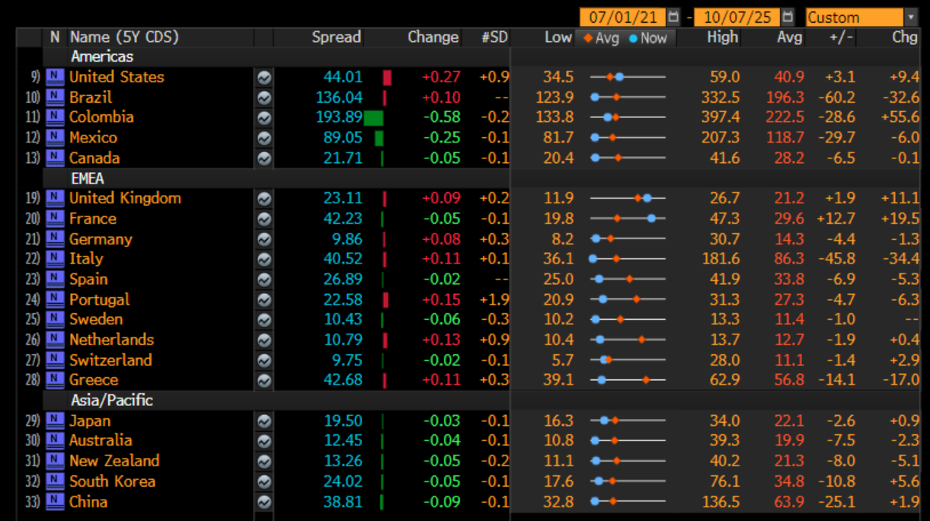
Not risk free
Credit premia remain stable
Source: Bloomberg LLP, October 2025
*Bloomberg function ‘SOVR’

Slide 8
Japan’s Fixed income Market – the traditional model doesn’t work

Slide 9
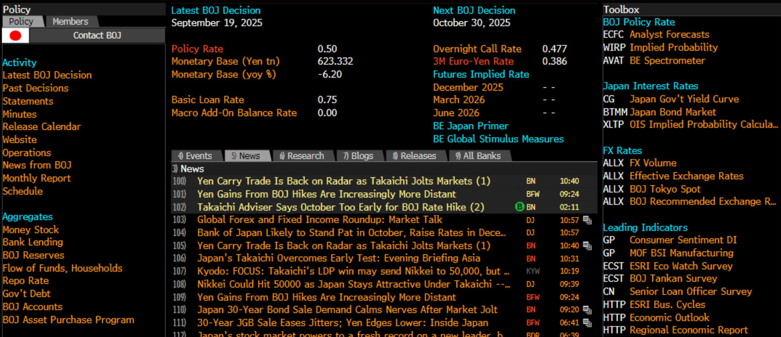
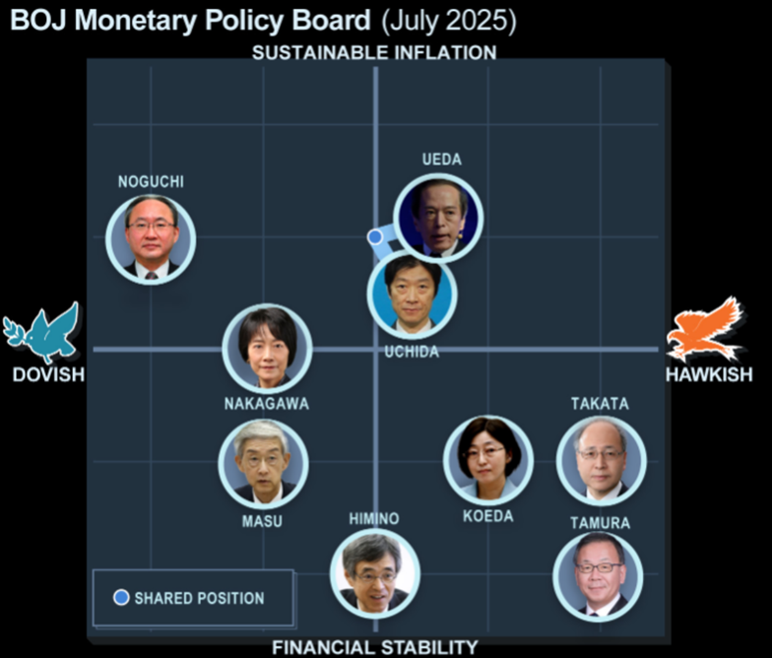
Bank of Japan
Source: Bloomberg LLP, CAIM, , October 2025
*Bloomberg function ‘BOJ’ & ‘AVAT’

Slide 10
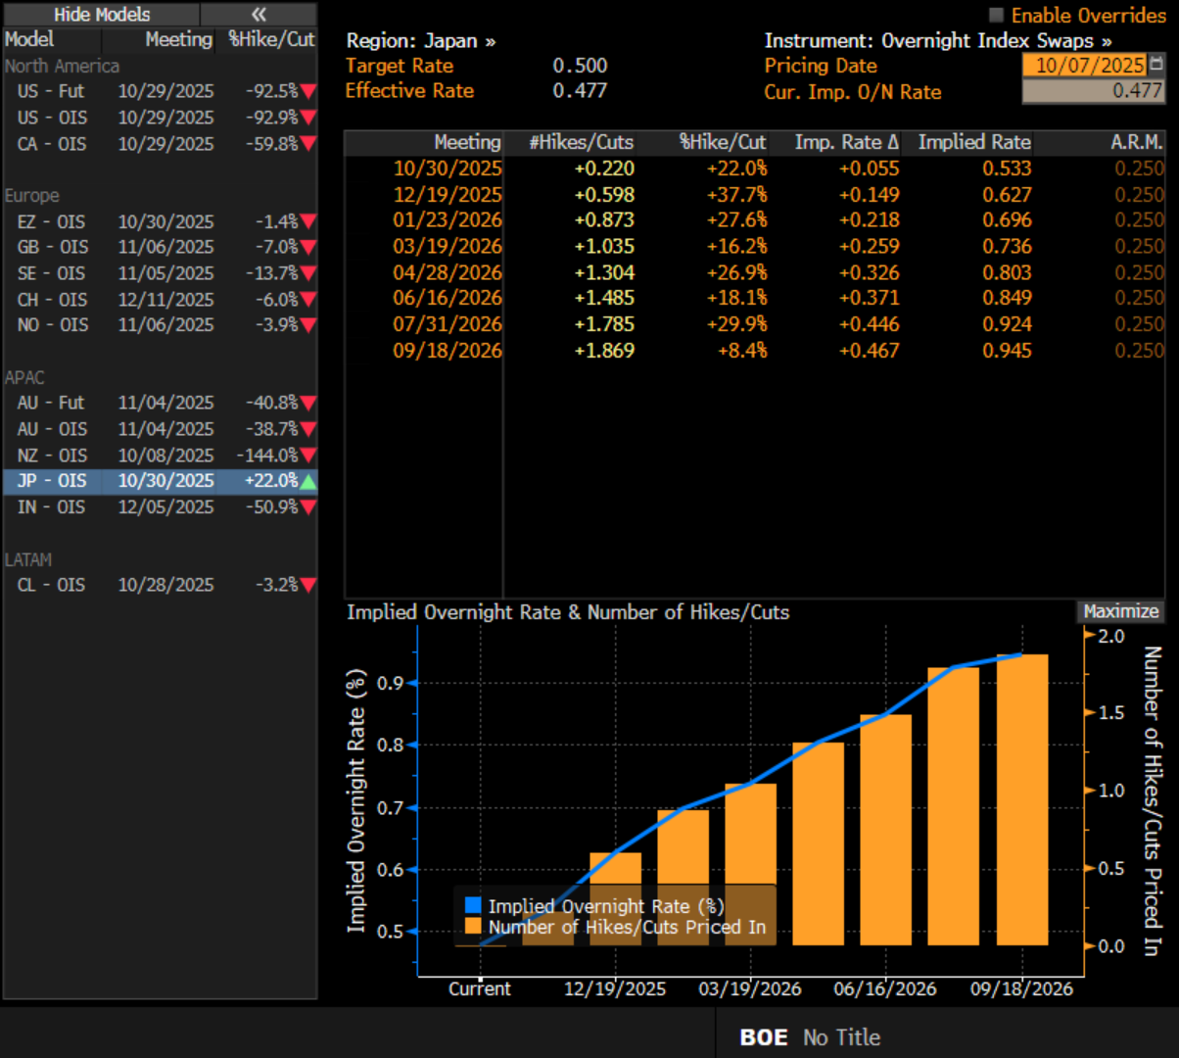
Yen rates - trajectory divergence
The BoJ has been the only central bank in developed world expected to increase rates
Source: Bloomberg LLP, CAIM, , October 2025
*Bloomberg function ‘WIRP’

Slide 11
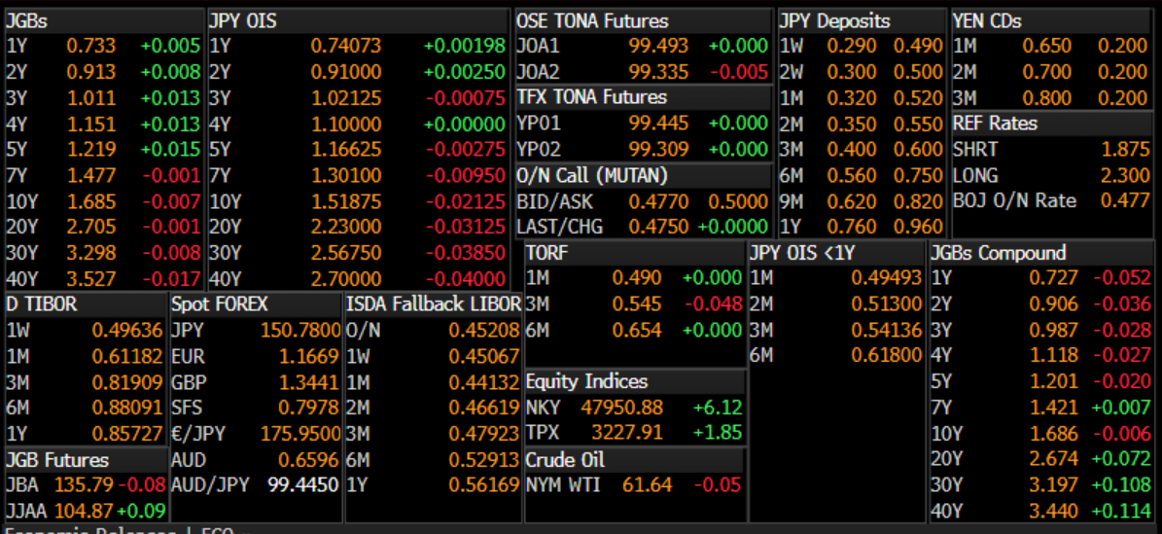
Foreign investors monitoring the government bond market but focused more on the IRS market
In transition. Moving from Z-Tibor to TONA
Source: Bloomberg, CAIM, , October 2025
*Bloomberg function ‘BTMM JN’

Slide 12
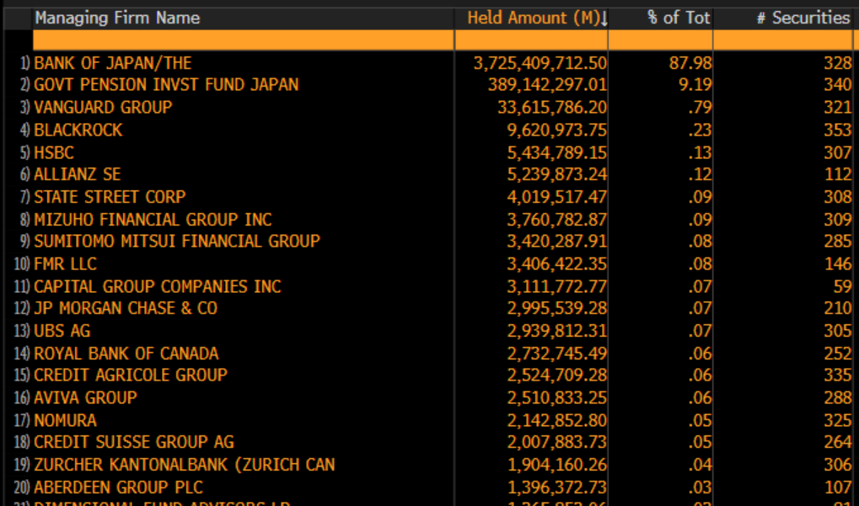
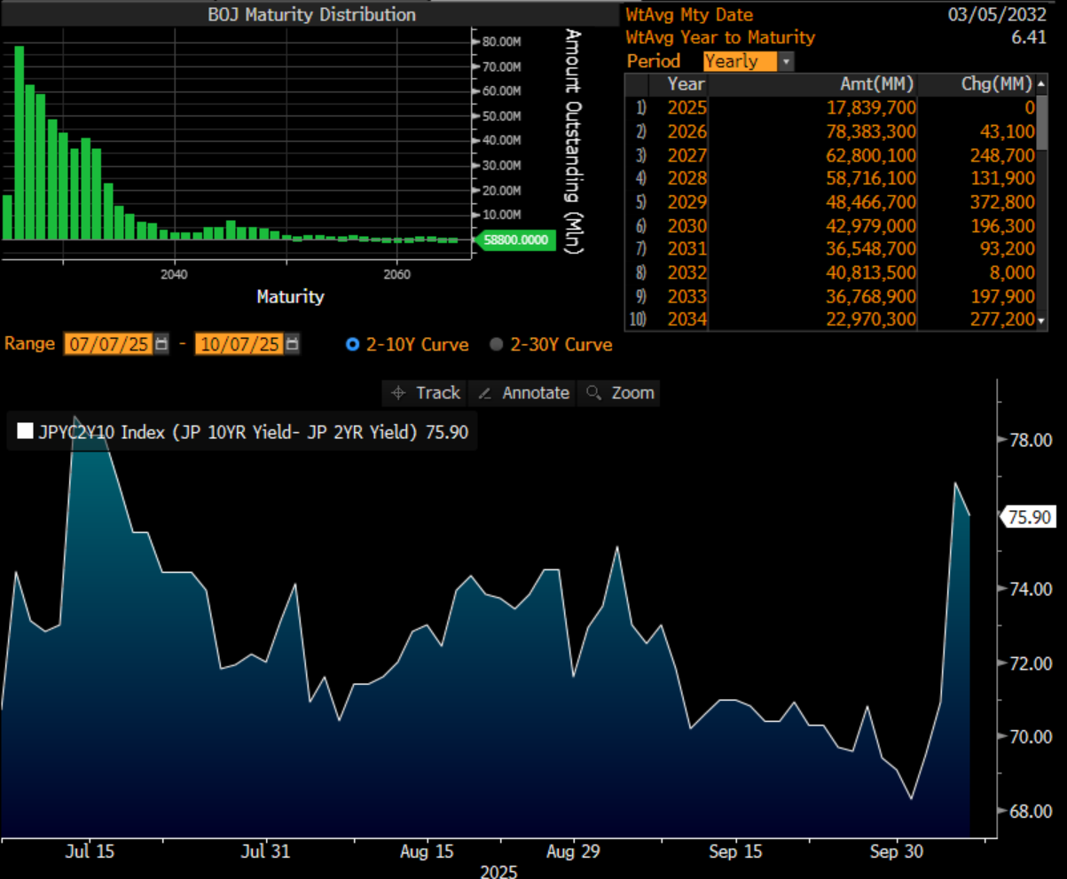
JGB ownership structure
The ownership structure should offer BoJ a fair amount of monetary independence.
‘One man show’
The BoJ Maturity distribution
Source: Bloomberg LLP, CAIM, , October 2025
*Bloomberg function ‘DEBT’

Slide 13
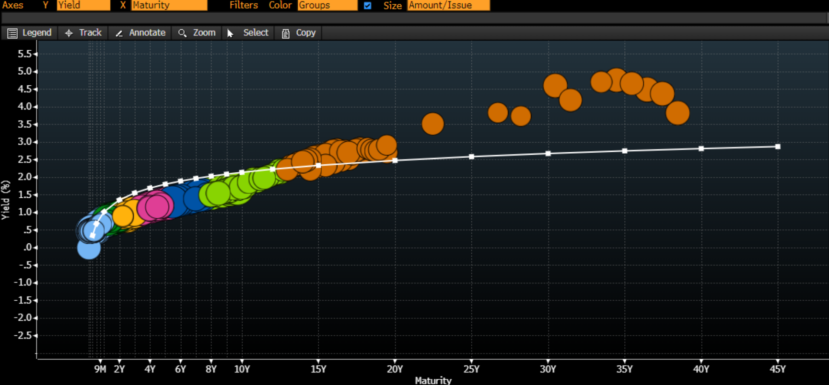
JGB the steepest curve in years
Despite domestic ownership the upward pressure on yields persists
Source: Bloomberg LLP, CAIM, , October 2025
*Bloomberg function ‘FIW’

Slide 14
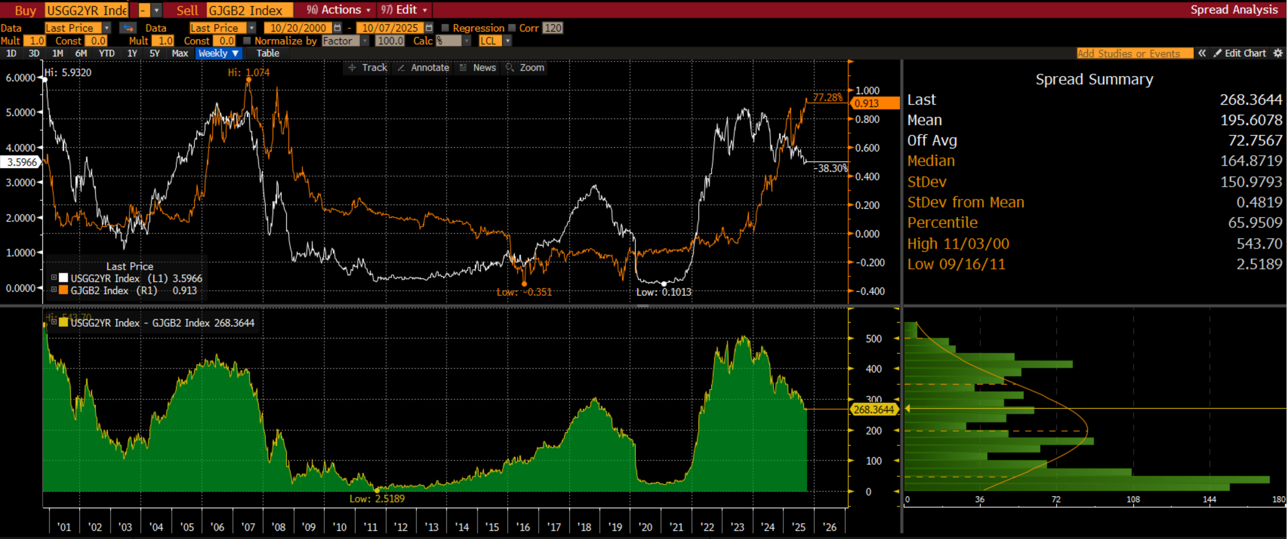
Interest rate differential roller coaster
The 2 year UST versus the 2 year JGB differential over the last decade
Source: Bloomberg LLP, CAIM, , October 2025
*Bloomberg function ‘ISIN 1 + ISIN 2 + HS’

Slide 15
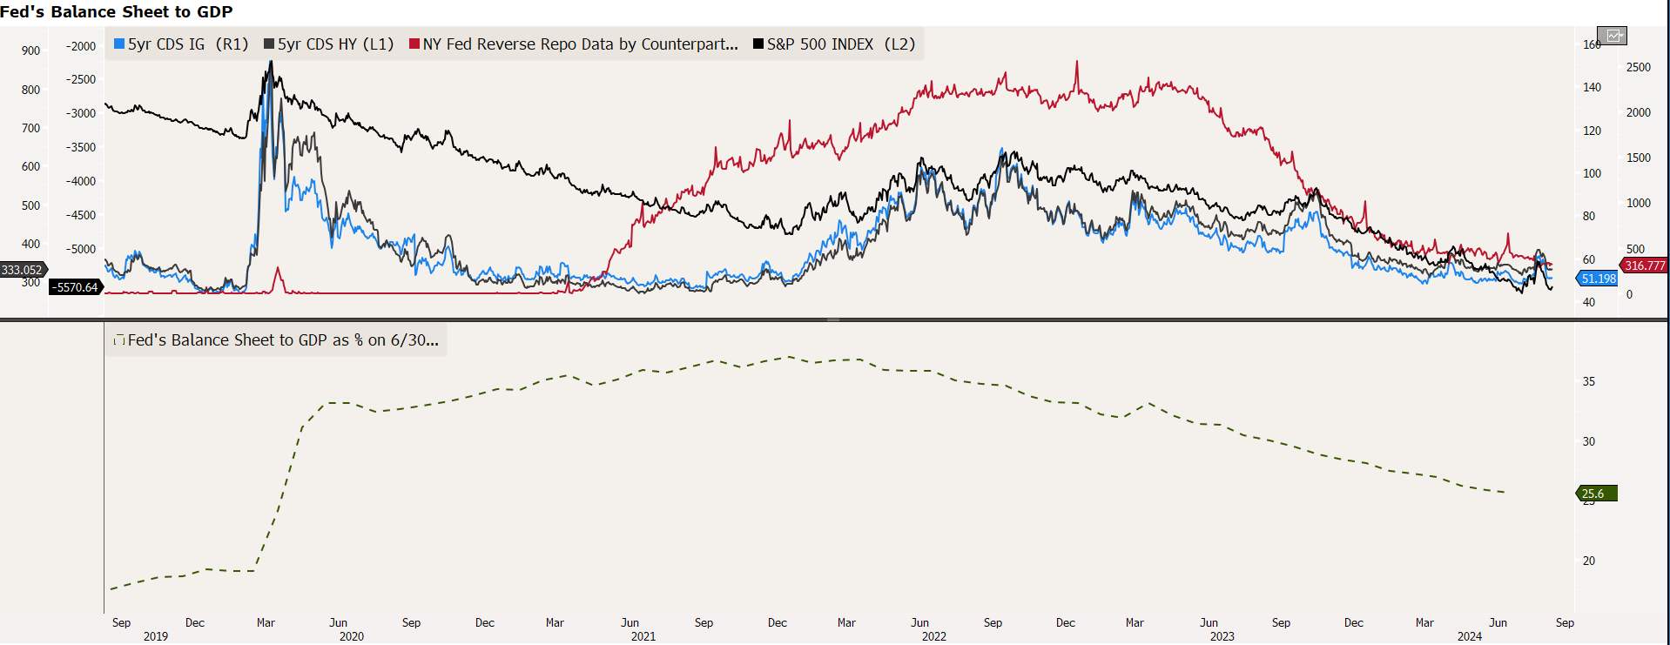
Interest rate differential too big to ignore
The FED applied one of the most aggressive monetary policy normalisations in history but policed risk through the balance sheet
US-Japan interest rate differential ballooned
While CBs balance sheets have promoted risk taking culture
Source; Bloomberg LLP, CAIM October 2025

Slide 16
FX – the Weak and the Weaker
And the price BOJ pays is the FX stability
Source: Bloomberg LLP, September 2025

Slide 17
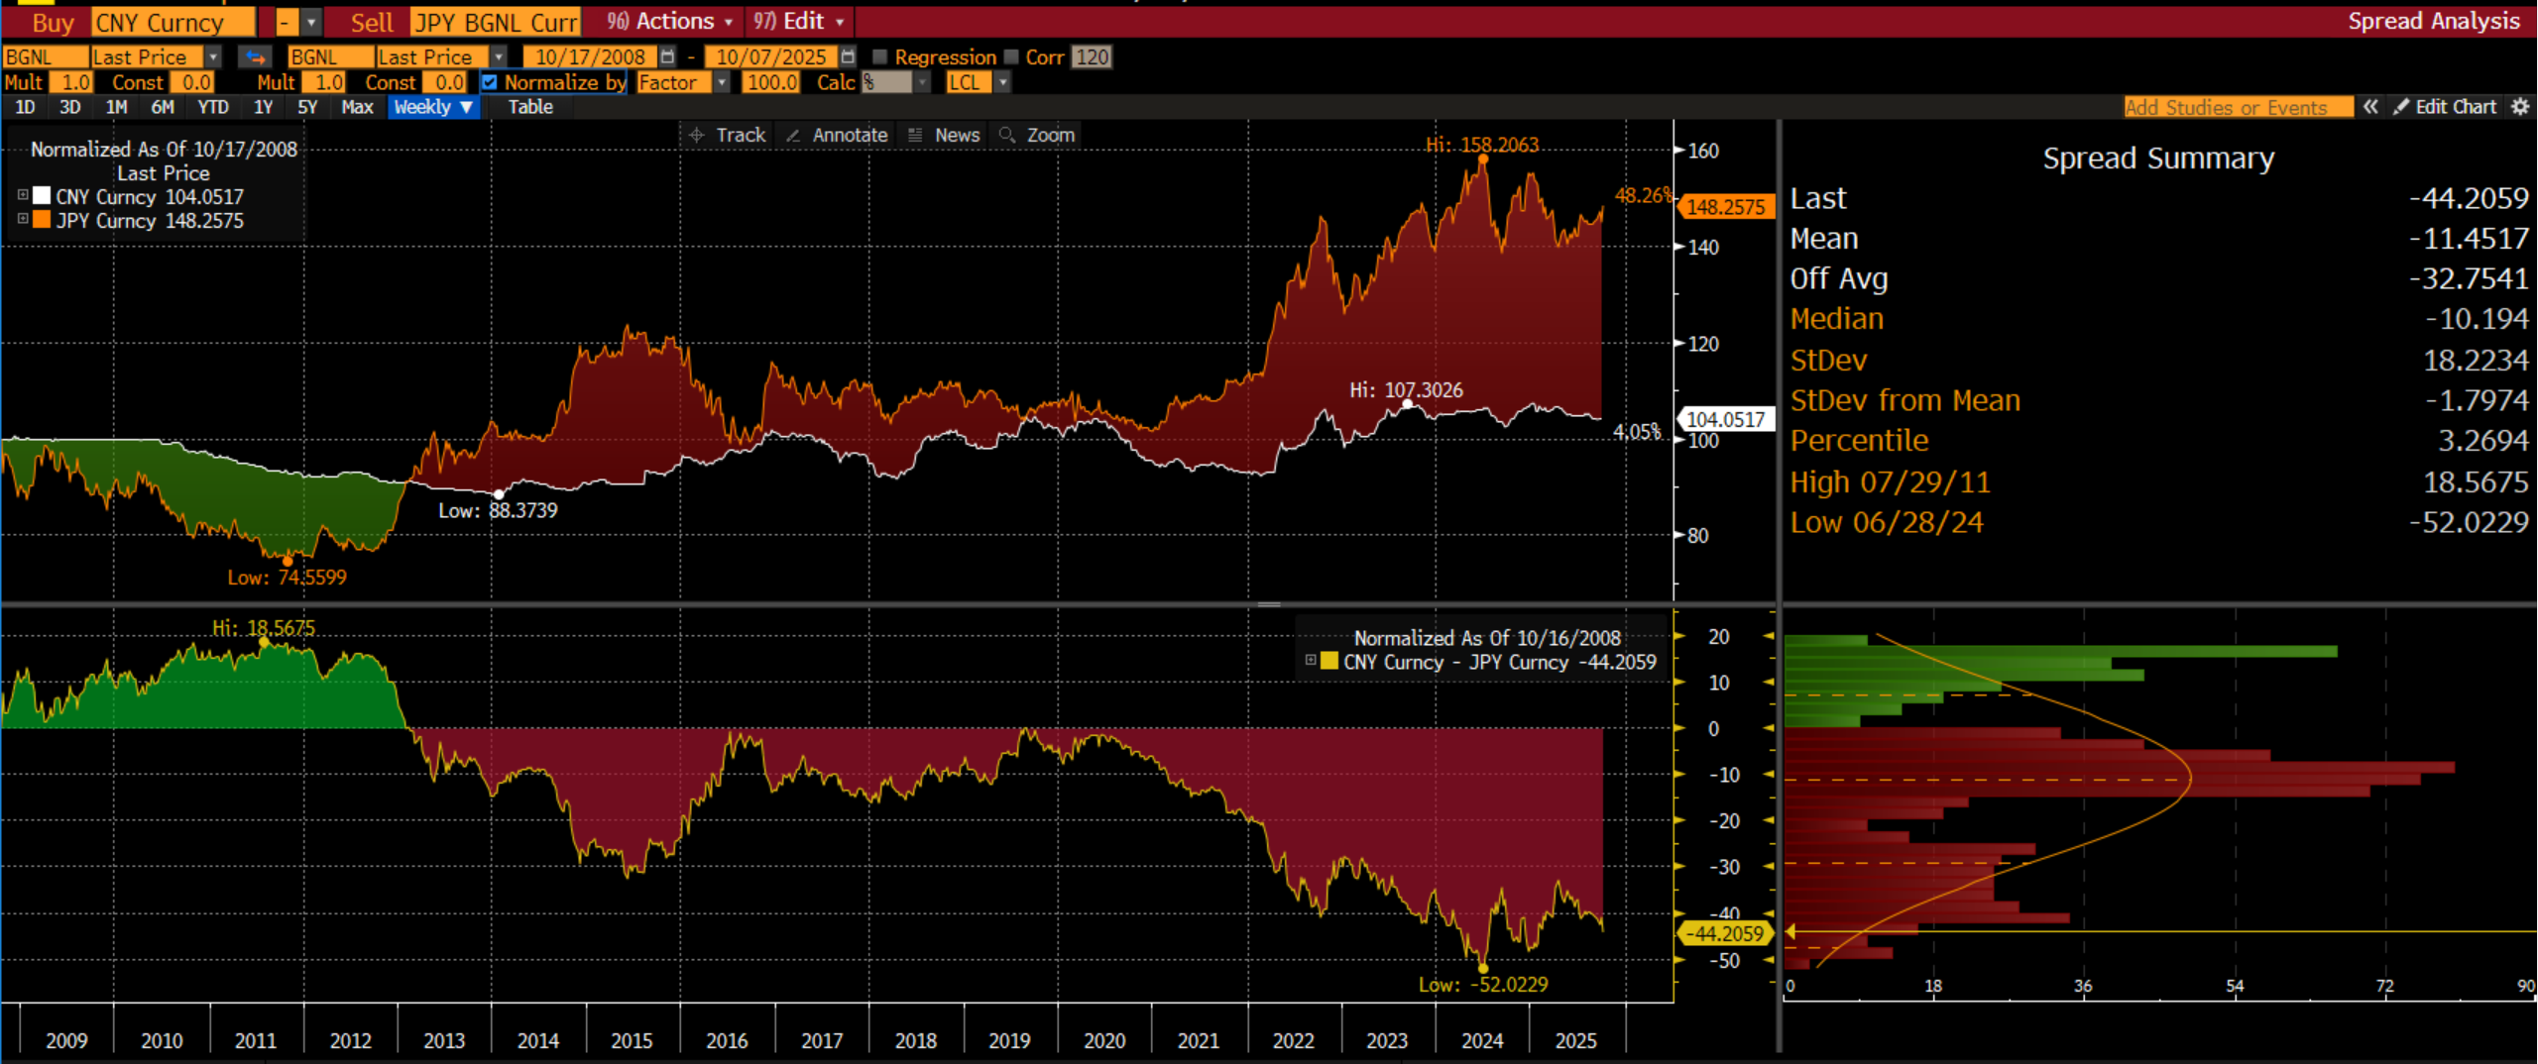
FX – stability does matter
FX rate behaviour one of the key measures of investors’ confidence
Source: Bloomberg LLP, September 2025

Slide 18
China’s Fixed income Market – the traditional model still works

Slide 19
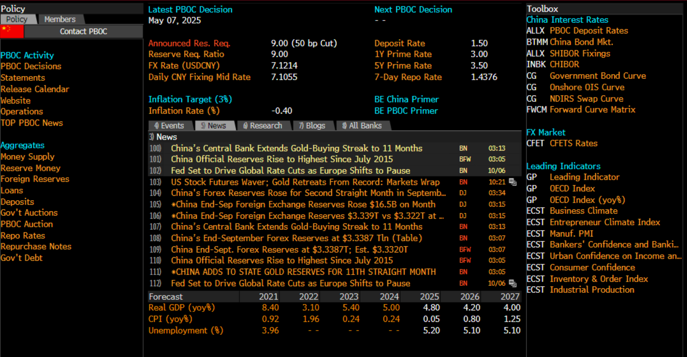
PBoC and old central bank model
PBoC remains in full control
Source: Bloomberg LLP, CAIM, , October 2025
*Bloomberg function ‘’

Slide 20
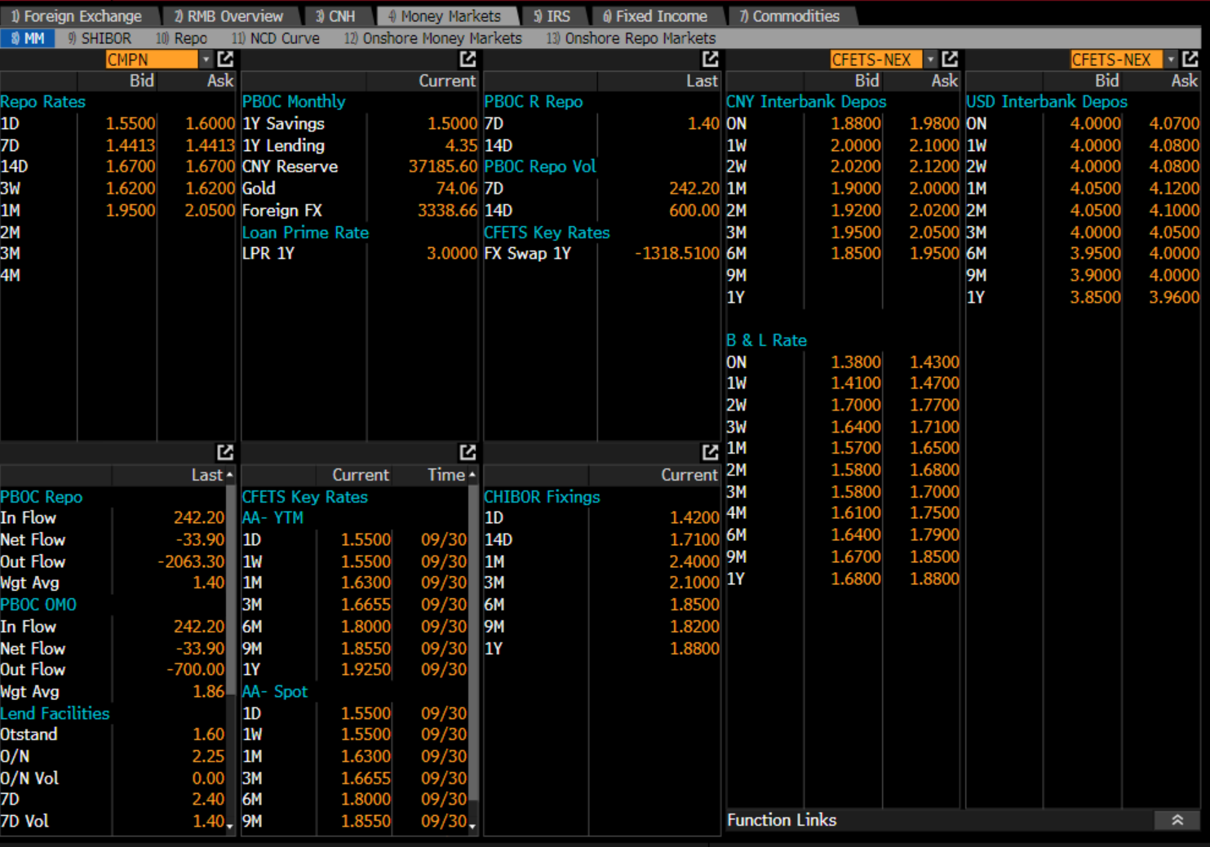
Chinese sophisticated ‘Hybrid’
A journey to a ‘free market’ model
Source: Bloomberg LLP, CAIM, , October 2025
*Bloomberg function ‘OTC China’

Slide 21
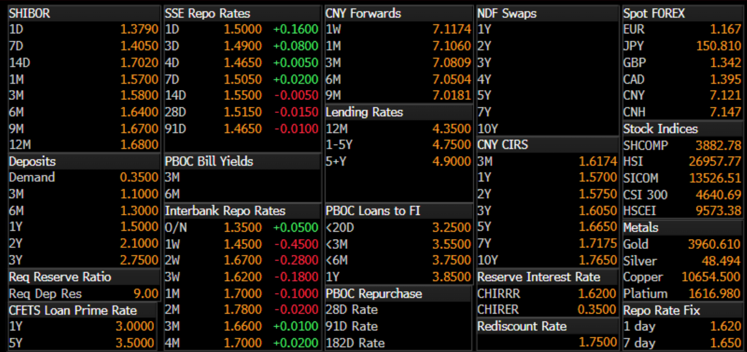
The second largest fixed income market
A journey into a developed market format
Source: Bloomberg LLP, CAIM, , October 2025
*Bloomberg function ‘BTMM China’

Slide 22
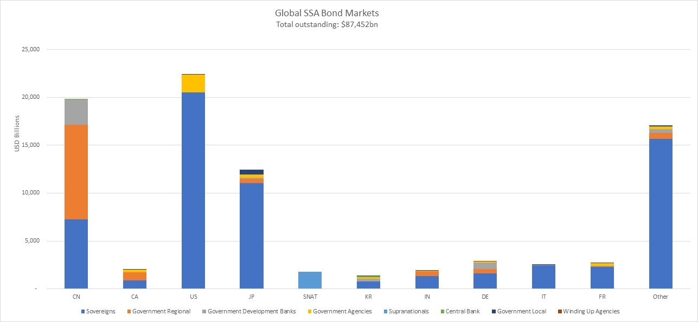
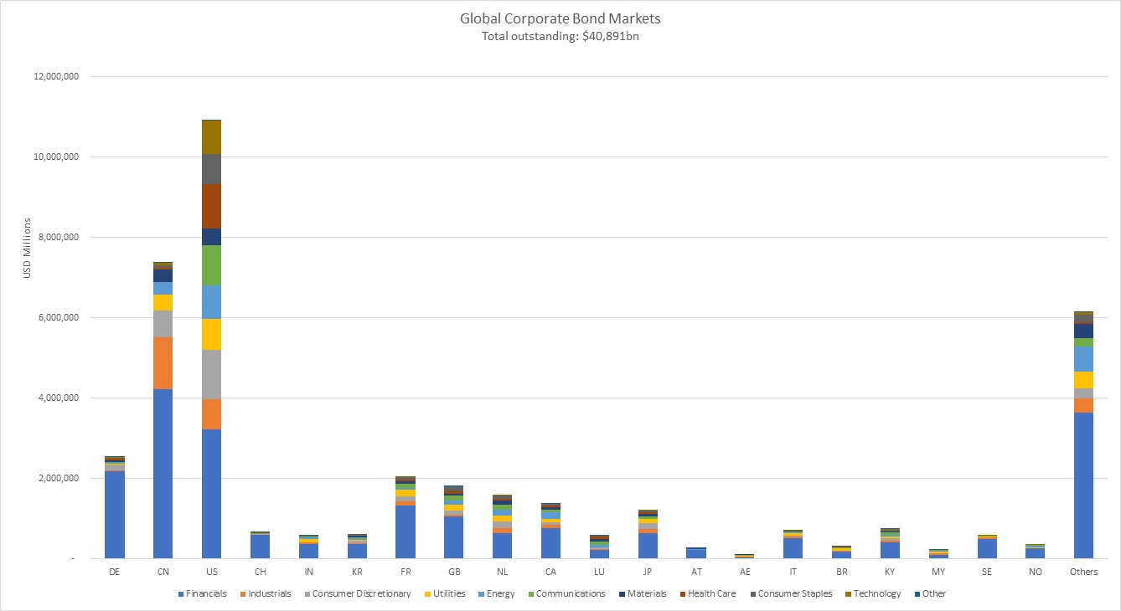
Global Fixed Income market
The Sovereign allocation is twice that of the corporate allocation
Source; Fitch, August 2024

Slide 23
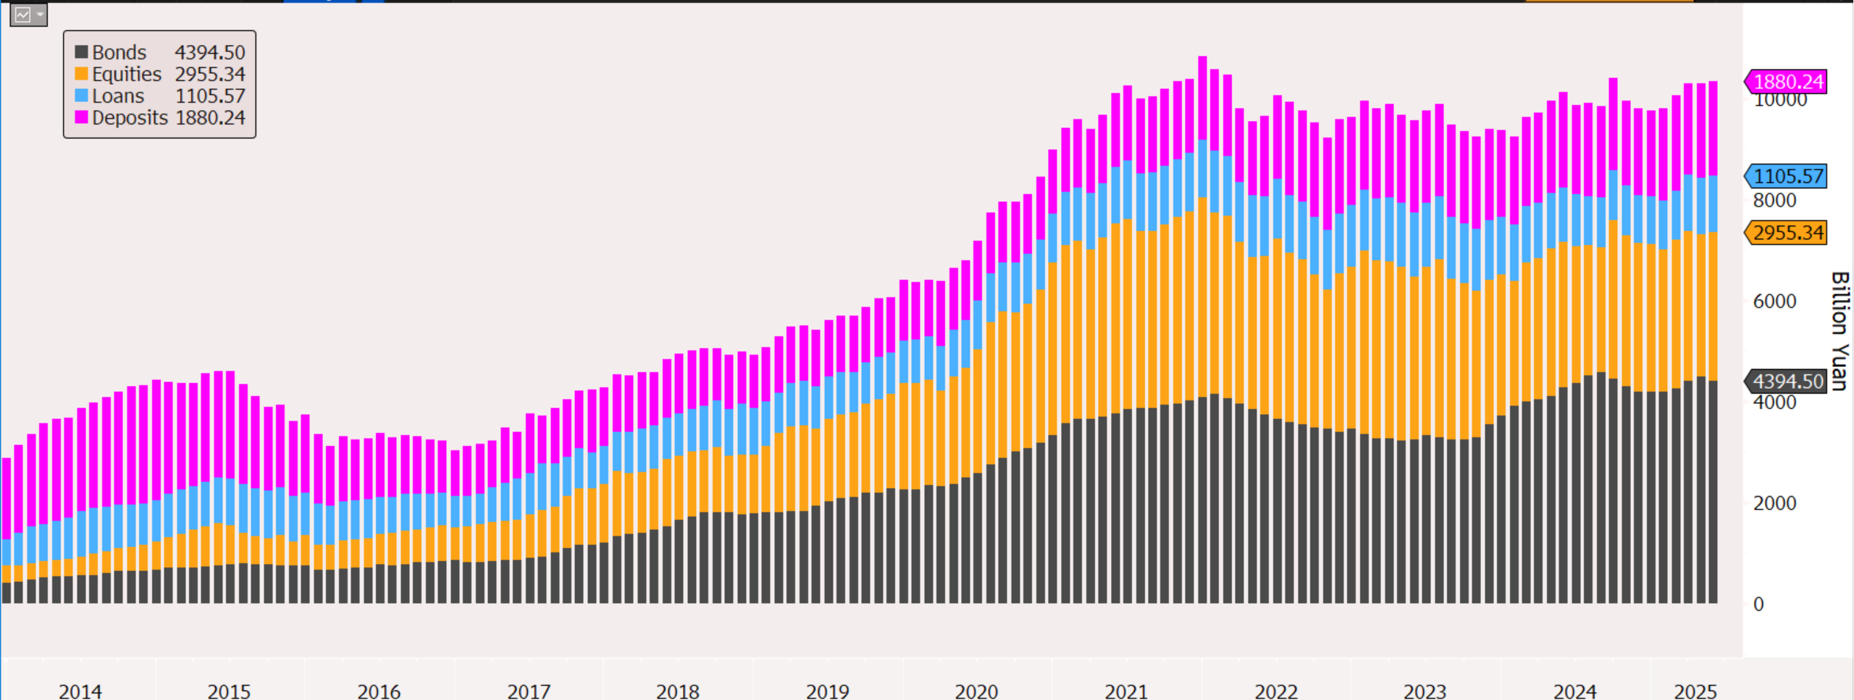
China – too big to ignore
China Domestic Assets held by Overseas Entities
Source Bloomberg LLP, PBOC, September 2025

Slide 24
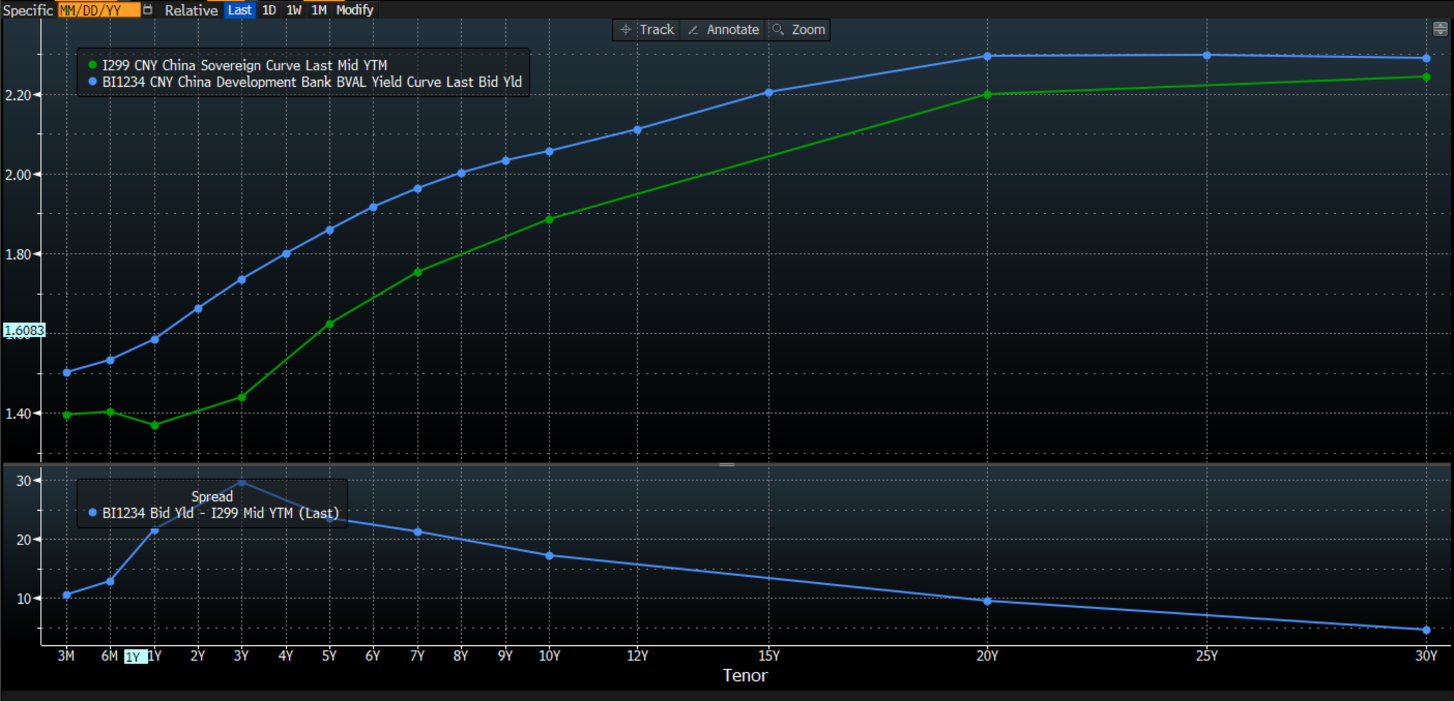
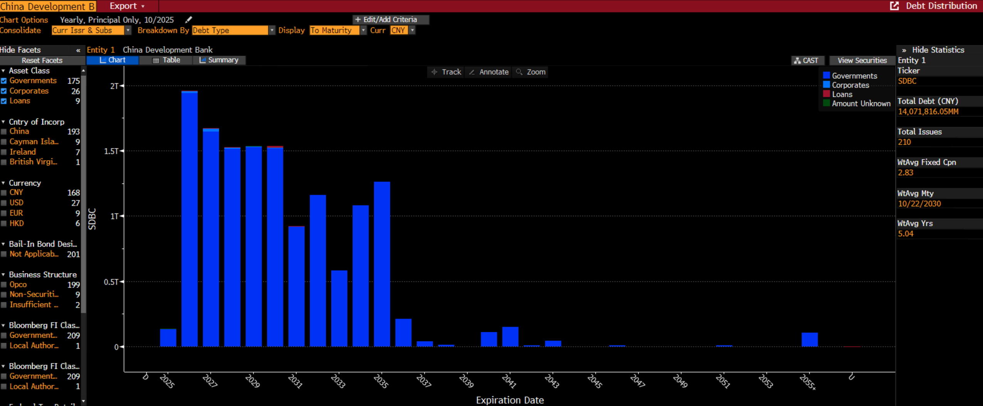
Onshore market
Policy Banks bonds trading volumes often exceed CGBs volumes.
There are three Policy Banks. China Development Bank is the largest issuer = the benchmark
Source: Bloomberg LLP, CAIM, , October 2025
*Bloomberg function ‘GC ‘ ‘DDIS’

Slide 25
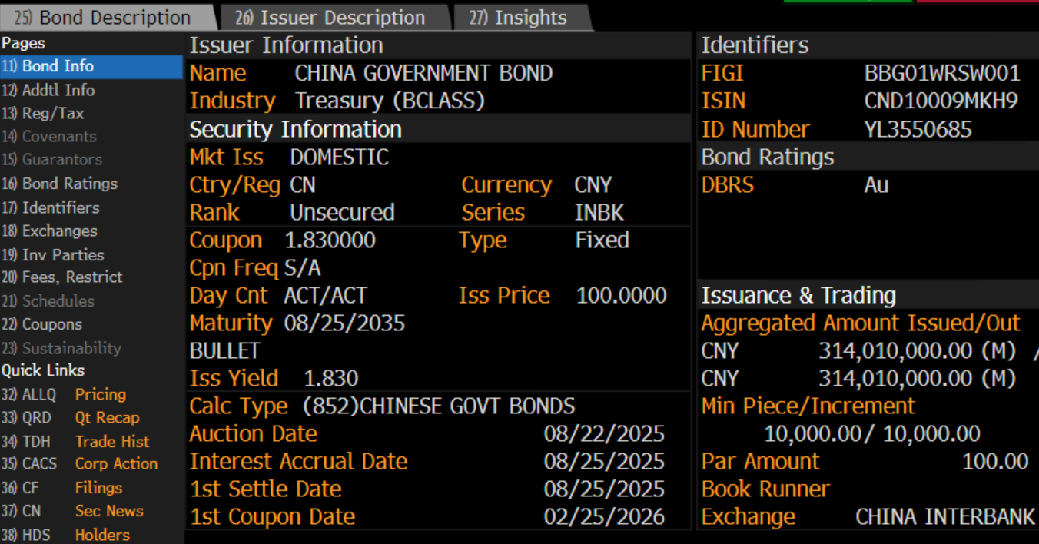
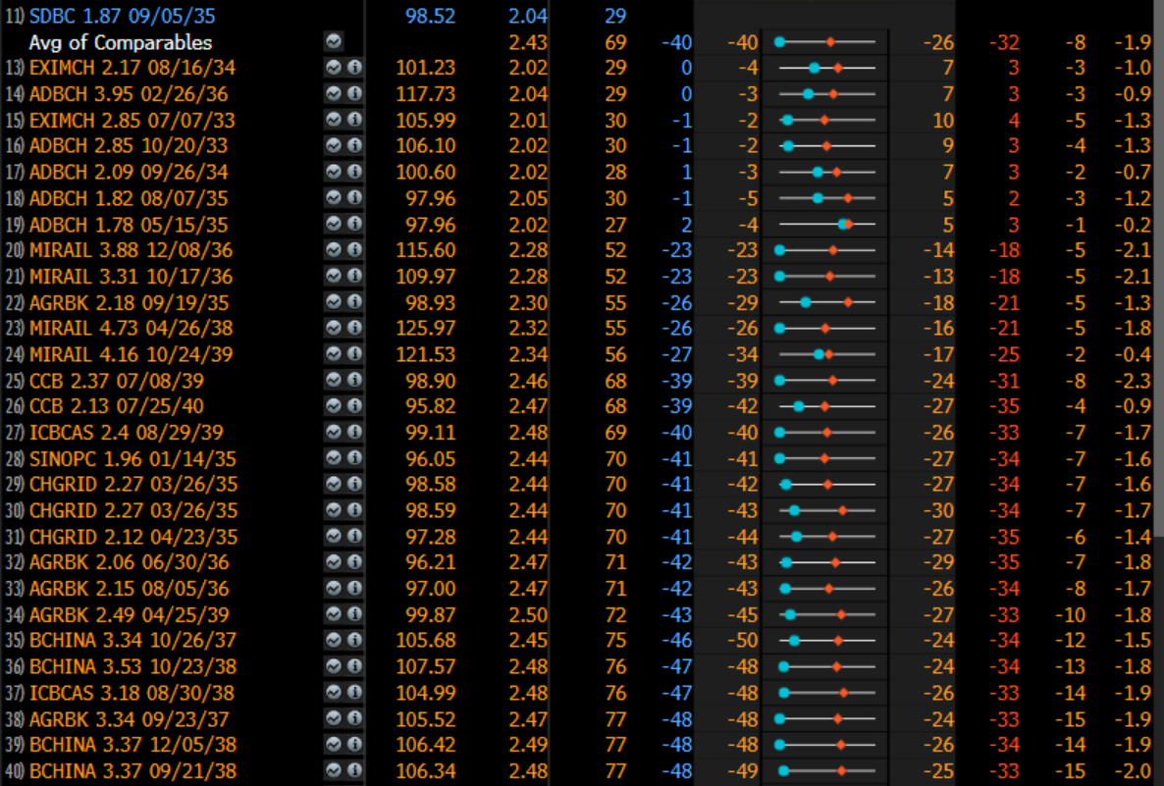
Onshore vs ‘onshore’ market
Dim-Sum offers yield enhancement, but it come at a price…
CGB – the current 10yr ‘on the run’
China Development Bank
Source: Bloomberg LLP, CAIM, , October 2025
*Bloomberg function ‘ISIN + DES’ ‘ ISIN + COMB

Slide 26
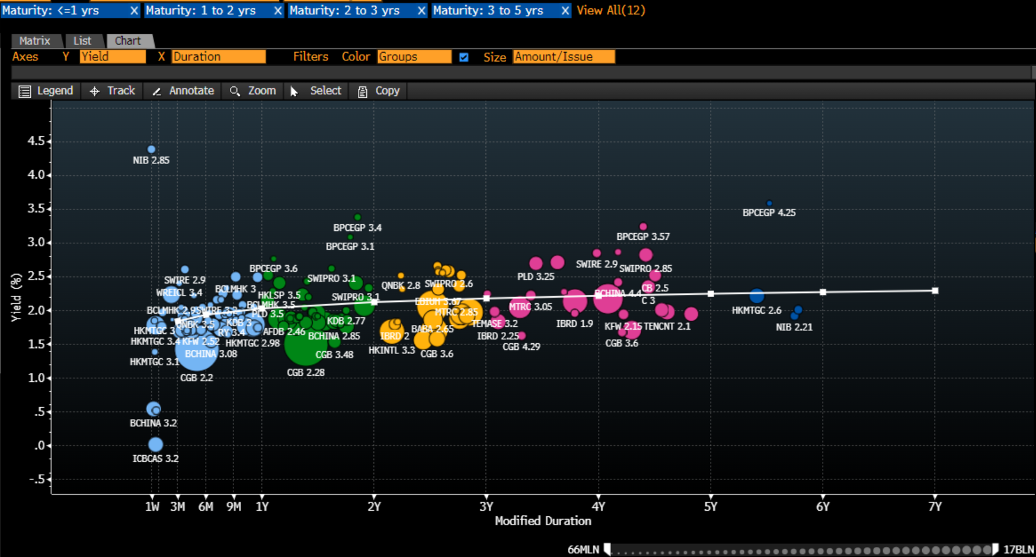
offshore vs onshore market
Dim-Sum (Offshore) – yield and credit enhancement, but it come at a price…
Source: Bloomberg LLP, CAIM, , October 2025
*Bloomberg function ‘FIW’

Slide 27
offshore vs onshore market (2)
Panda Market (Onshore) – substantial progress with ‘admin’ hurdles
Source: Bloomberg LLP, CAIM, , October 2025
*Bloomberg function ‘FIW’

Slide 28
FX – challenges remain
PBoC are alert to market developments
Source: Bloomberg LLP, September 2025

Slide 29
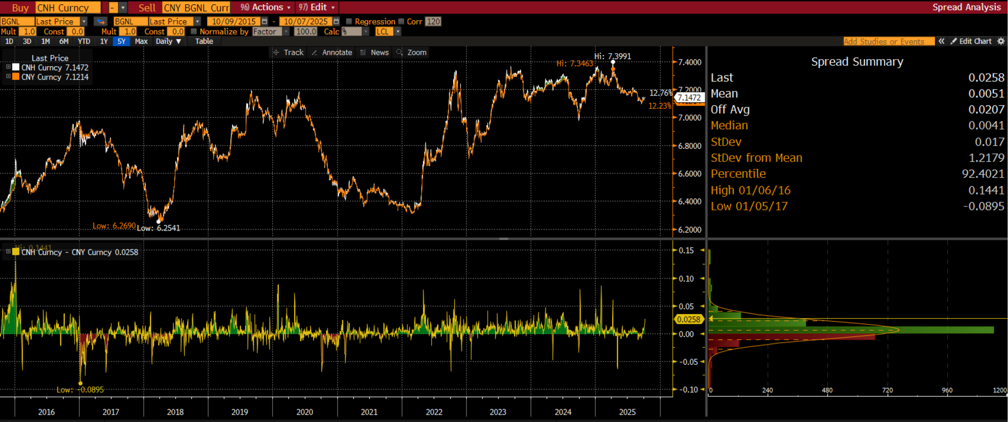
One country – one Currency?
The CNH/CNY relationship still a good barometer for China’s international perception
Source: Bloomberg LLP, CAIM, , October 2025
*Bloomberg function ‘ISIN 1 + ISIN 2 + HS’

Slide 30
Appendix

Slide 31
Bond connect versus CIBm
By the end of August 2023, 736 and 811 FII’s registered through CIBM and Bond Connect respectively
Foreign investors transactions per venue as of August 2022
Source CfetsOnline, As of August 2023

Slide 32
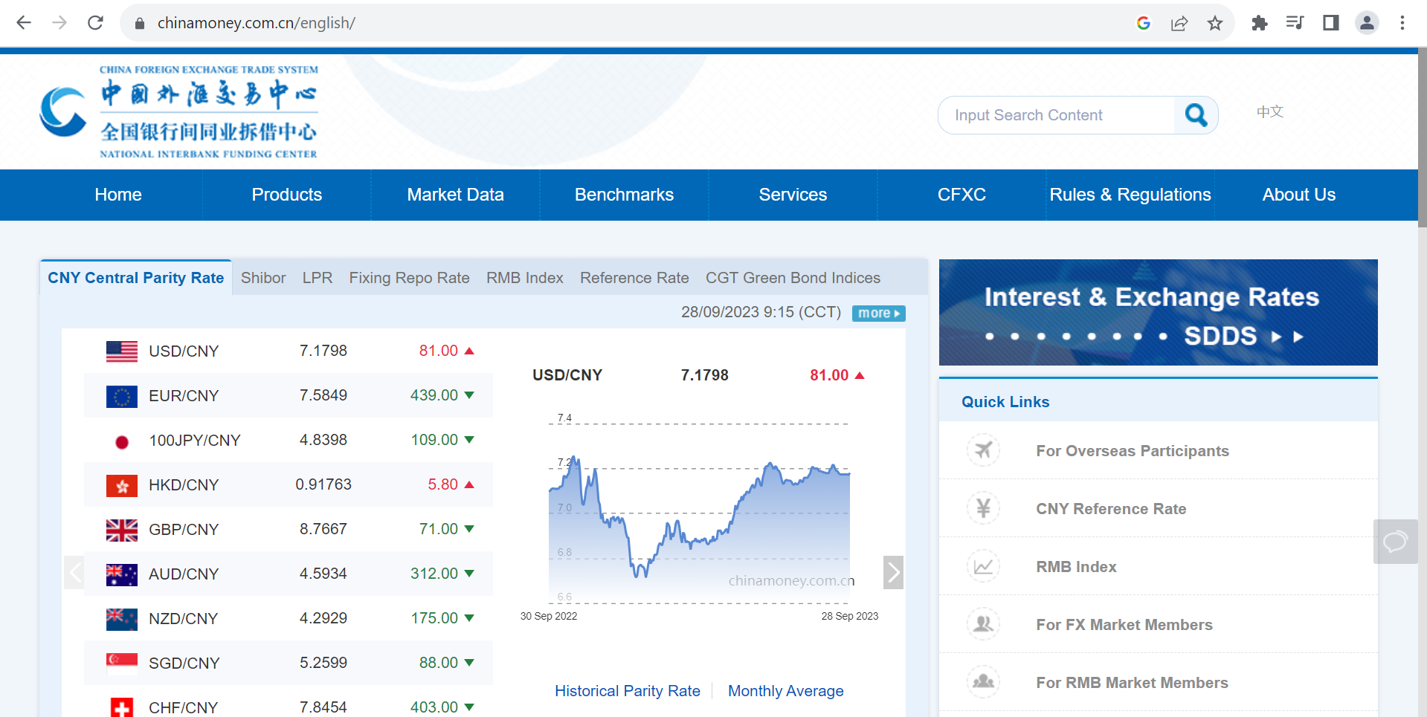
China Foreign Exchange Trade System
Chinamoney.com.cn is the main page to get information on products/Market Data/Rules and Regulations
Source CAIM, CFETS, September 2023

Slide 33

Bond Connect
www.chinabondconnect.com
Source,; Bond connect, September 2024

Slide 34
RMB = CNY + CNH ?
The CNY ‘World’ is defined by 24 currencies
The CNY basket is announced annually, the PBOC announces the fixings each working day 09:15 GMT + 8, allowing 2% deviation
Top 7 Currencies
USD | 19.83%
EUR | 18.20%
JPY | 9.75%
KRW | 9.50%
AUD | 6.07%
MYR | 4.64%
RUB | 3.85%
Source: PBOC, 31 December 2022

Slide 35
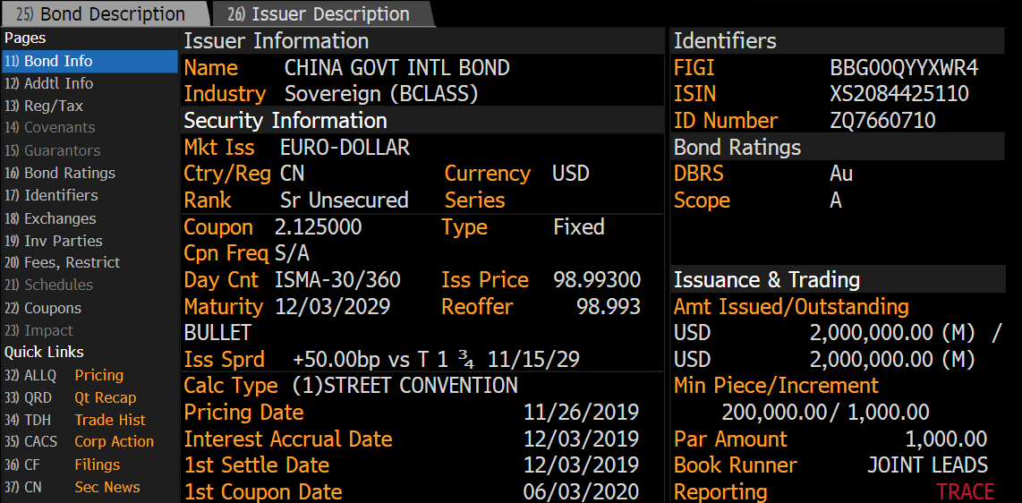
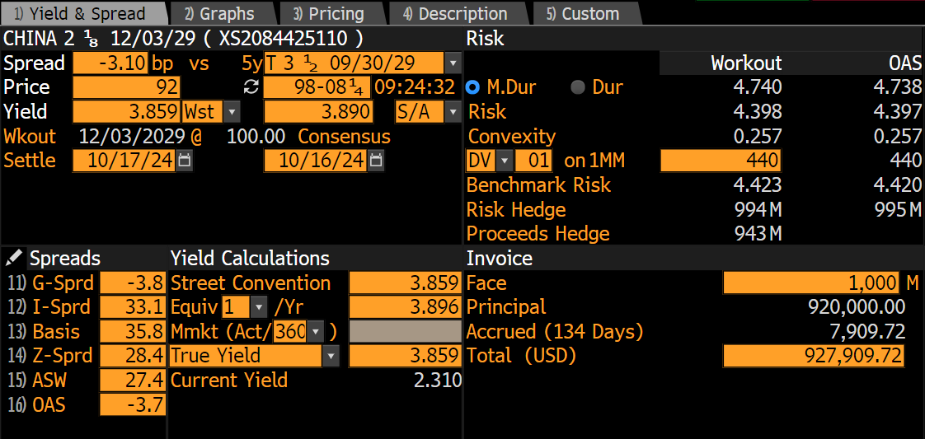
China international bonds
China ‘maintains’ curves in the USD and the EUR
Source: Bloomberg, CAIM, , October 2024
*Bloomberg function ‘ISIN + DES’, YAS

Slide 36
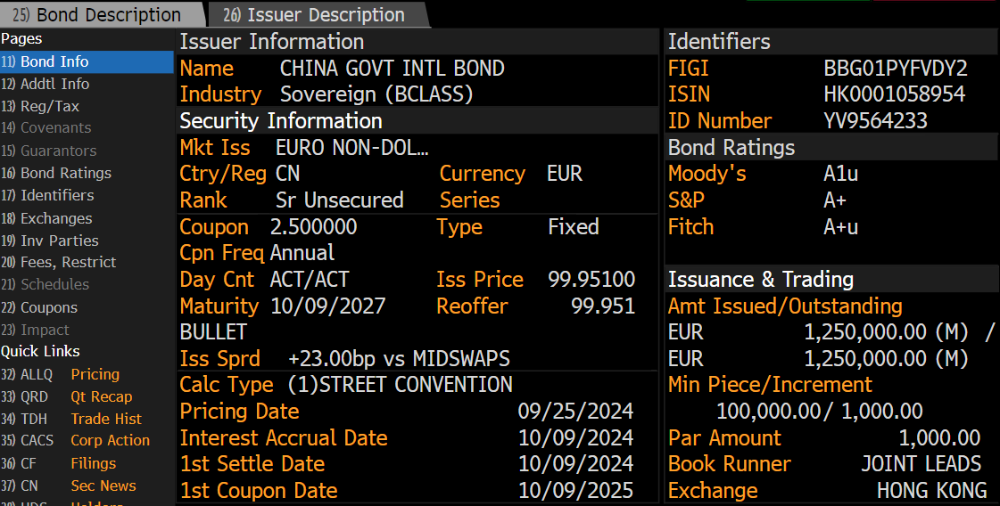
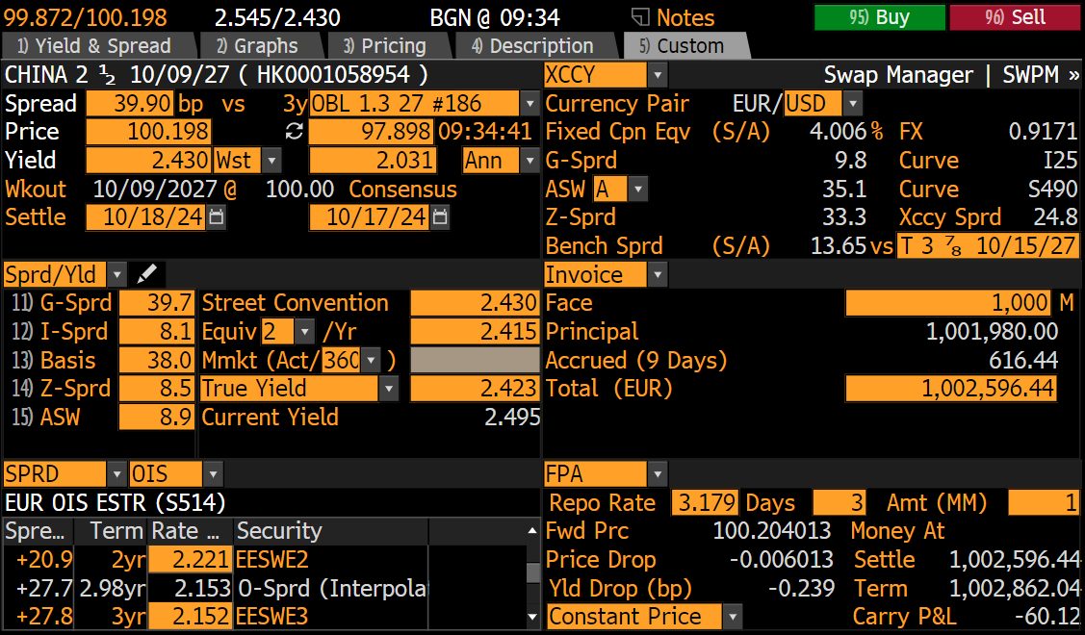
China international bonds
China ‘maintains’ curves in the USD and the EUR
Source: Bloomberg, CAIM, , October 2024
*Bloomberg function ‘ISIN + DES’, YAS XCCY

